Slide 1
Queues

Slide 2
The Queue ADT
The Queue ADT stores arbitrary objects
Insertions and deletions follow the first-in first-out scheme
Insertions are at the rear of the queue and removals are at the front of the queue
Main queue operations:
enqueue(object): inserts an element at the end (rear) of the queue
dequeue(): removes the element at the front of the queue
Auxiliary queue operations:
object front(): returns the element at the front without removing it
integer size(): returns the number of elements stored
boolean empty(): indicates whether no elements are stored
Exceptions
Attempting the execution of dequeue or front on an empty queue throws an QueueEmpty

Slide 3
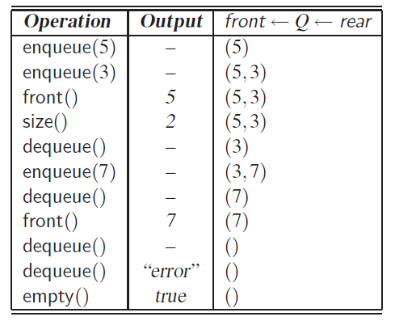
Example
Operation Output Q
enqueue(5) – (5)
enqueue(3) – (5, 3)
dequeue() – (3)
enqueue(7) – (3, 7)
dequeue() – (7)
front() 7 (7)
dequeue() – ()
dequeue() “error” ()
empty() true ()
enqueue(9) – (9)
enqueue(7) – (9, 7)
size() 2 (9, 7)
enqueue(3) – (9, 7, 3)
enqueue(5) – (9, 7, 3, 5)
dequeue() – (7, 3, 5)

Slide 4
Applications of Queues
Direct applications
Waiting lists, bureaucracy
Access to shared resources (e.g., printer)
Multiprogramming
Indirect applications
Auxiliary data structure for algorithms
Component of other data structures

Slide 5

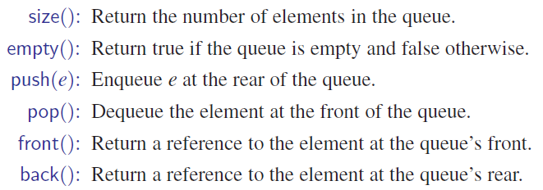
STL Queue
Based on the STL vector class
dynamically resizes itself when new elements are added
provides access to both the front and back of the queue
no exception is thrown, thus, illegal accesses should be taken care of by the programmer.

Slide 6
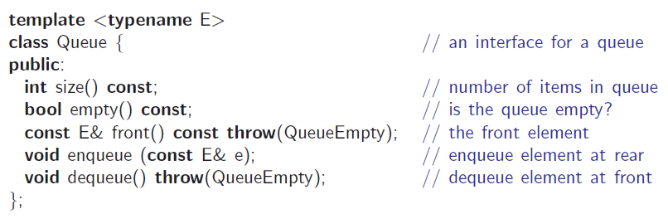
Queue Interface in C++
C++ interface corresponding to our Queue ADT
Requires the def-inition of exception QueueEmpty
No corresponding built-in C++ class

Slide 7
Array-based Queue
Use an array of size N in a circular fashion
Three variables keep track of the front and rear
f index of the front element
r index immediately past the rear element
n number of items in the queue
normal configuration
Q
0
1
2
f
r
wrapped-around configuration
Q
0
1
2
r
f

Slide 8
Queue Operations
Use n to determine size and emptiness
Algorithm size()
return n
Algorithm empty()
return (n = 0)
Q
0
1
2
f
r
Q
0
1
2
r
f

Slide 9
Array-based Queue
Issues with the normal configuration.
normal configuration
Q
0
1
2
f
r

Slide 10
Queue Operations (cont.)
Algorithm enqueue(o)
if size() = N − 1 then
throw QueueFull
else
Q[r] ← o
r ← (r + 1) mod N
n ← n + 1
Operation enqueue throws an exception if the array is full
This exception is implementation-dependent
Q
0
1
2
f
r
Q
0
1
2
r
f

Slide 11
Queue Operations (cont.)
Operation dequeue throws an exception if the queue is empty
This exception is specified in the queue ADT
Algorithm dequeue()
if empty() then
throw QueueEmpty
else
f ← (f + 1) mod N
n ← n − 1
Q
0
1
2
f
r
Q
0
1
2
r
f

